Slide 1




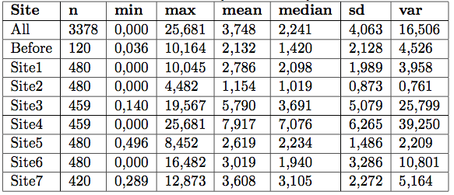








2DMT00 Applied statistics
Research Report – Group 11
Mingpeiyu Zhang - 1018903
Niels Hellinga - 0977787
Vishal Chouksey - 1034346
Problem Statement
An accident occurred in the factory and there is concern of release of a toxic substance at different site of the factory. Hence the levels of PPM were measured using 2 sensors on 7 sites hourly, up to 4 hours
Analysis & Procedure
Questions
Is/are there outlier/s in the data set?
Are the data normally distributed?
Do the PPM levels of the sites have different locations and variances compared to the PPM levels before the accident?
Summary Statistics:
Start
Paired sample test:
Check if Sensor 1 and Sensor 2 have the same distribution. Sensors of Site Before, Site 1 and Site 3 have the same distribution, while the distribution of the two sensors in the other 7 sites are significantly different.
Outliers Test:
We choose only to take the the testing result of Doornbos test. Since all the other tests assume that the samples come from a normally distributed population which we do not know so far. The results of other tests can not be trusted. We then remove the 2 detected outliers
Normality Test:
We have two cases where we can detect normality, namely Site Before with the transformed LOGPPM values and Site 5 for Sensor 1 with the ‘normal’ PPM values. Since the rest is not normally distributed and we cannot compare Site 5 to Site Before, we will need to use non-parametric tests.
Variance & Location:
Site 1, Site 5 (Sensor 2), Site 6 and Site 7 do not have different variances compared to the PPM levels before the accident. The location has changed for all the sites when compared to the Site Before.
Results:
Site 1 and 2 are not worse than normal level (safe).
Site 3, 4 and 6 are worse than normal level (unsafe).
Site 5 and 7 We cannot say.
Finish
Site 1
Site 2
Site 3
Site 4
Site 5
Site 6
Site 7
/ Department of Computer Science and Mathematics

